Slide 1
Secure Data Hiding in Image Using Steganography
CAPSTONE PROJECT
Presented By:
Student Name : MOHD ARSHAD
College Name & Department : Babu Banarasi Das Northern India Institute of Technology Lucknow & INFORMATION TECHNOLOGY

Slide 2
OUTLINE
Problem Statement
Technology used
Wow factor
End users
Result
Conclusion
Git-hub Link
Future scope

Slide 3
Problem Statement
In today's digital world, data security is crucial. Traditional encryption methods leave traces, making encrypted messages easy to detect. This project uses steganography to hide secret messages inside images, ensuring secure and undetectable communication.

Slide 4
Technology used
Programming Language: Python
Libraries Used: OpenCV, NumPy, OS
Image Processing: PNG format for lossless data storage
Concept Used: Least Significant Bit (LSB) Steganography

Slide 5
Wow factors
✅ Stealthy Encryption: Unlike traditional cryptography, this method leaves no visible traces. ✅ Image-Based Data Hiding: Secret messages are embedded in image pixels. ✅ Password-Protected Decryption: Ensures only authorized users can retrieve the message. ✅ Custom-Built Algorithm: Designed for minimal image distortion while maintaining secrecy.

Slide 6
End users
Journalists & Whistleblowers – Secure communication without detection.
Government & Defense – Covert messaging in cybersecurity.
Corporate Communication – Confidential data exchange.
Individuals Concerned About Privacy – Personal data protection.

Slide 7
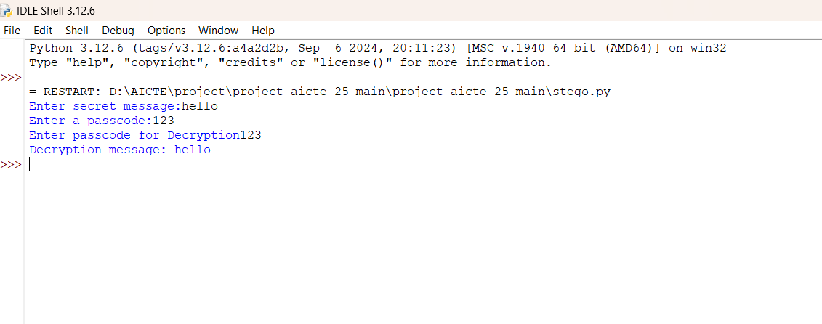
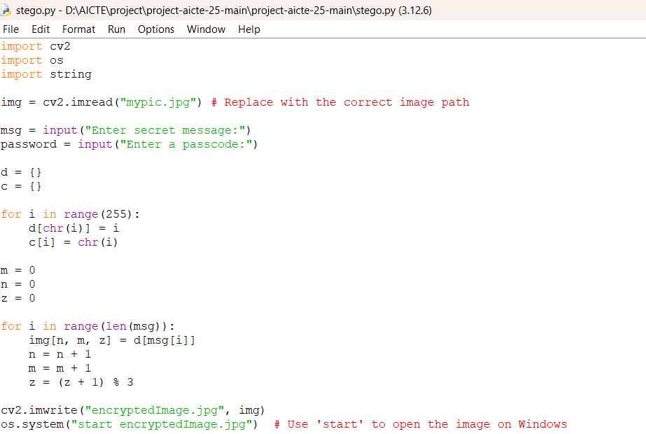
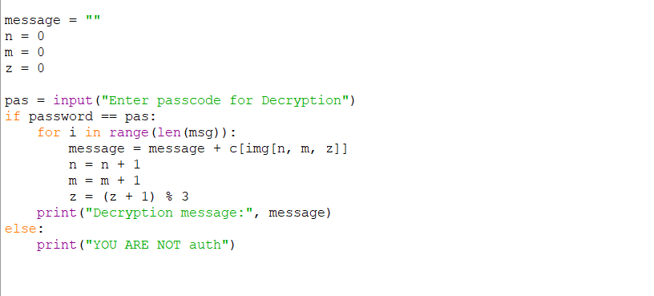
Results
1️⃣ Encrypted Code 2️⃣ Decrypted Code 3️⃣ Result

Slide 8
Conclusion
This project successfully demonstrates the use of steganography for secure communication. By embedding messages in images, we achieve a covert method of encryption that is hard to detect. With further improvements, this technique can be extended to videos and real-time applications.

Slide 9
GitHub Link
https://github.com/MohdArshad-cell/Aicte-project.git

Slide 10
Future scope(optional)
📌 Enhancements for Future Versions:
Video-Based Steganography: Extend the method to videos.
AI-Based Image Optimization: Reduce distortion while encoding messages.
Higher Security: Multi-layer encryption before embedding in images.

Slide 11
THANK YOU

